Slide 1

Rain Water Detection System TEITA-1
St. Francis Institute of Technology
Department of Information Technology
Mini Project – Sensor Lab (ITL 603)
Vedant Kadam 1
Ethan Moraes 2
Josh Jestine 3
Akshat Oza 4
Pratham Gaonkar 16
Mentor:
Dr. Prachi Raut
HOD

Slide 2
Overview
Introduction
Literature Survey
Research Gaps
Problem Statement
Objectives
System Design
Hardware and Software Requirements
Circuit Diagram
Results & Discussion
Conclusion
References

Slide 3
Introduction
This project has a variety of applications, ranging from agriculture to various different rain monitoring applications such as turfs, automatic roofs, etc
The detection system helps solve the problem of automating systems when rain is detected over a large area.
Rainwater Detection system uses a rain sensor connected to a NodeMCU (ESP8266) along with buzzers and LED.
The system could detect rain and immediately turn on the roof/activate sheds/countermeasures in agricultural land.

Slide 4
Literature Review
From the first research paper we learned about the combination of a commercial light detection and ranging (LiDAR) sensor and a microcontroller board. The LiDAR sensor is used to detect rainfall, and the microcontroller board is used to collect and process the data from the sensor. [1]
The second research paper stressed on keeping the design user-friendly, with a mobile application that allows homeowners to monitor the system and adjust its settings. [2]
Lastly the final learning involved collecting and analyzing data from microwave links between cellular communication towers. The research was based off a technique called attenuation-based rainfall estimation, which involves measuring the attenuation of the microwave signals as they pass through the atmosphere [3]

Slide 5
Research Gaps
We have not accounted for inaccuracy of the sensor in detecting rainwater.
Our sensor may become dysfunctional rapidly from the wear and tear associated with the continual pouring of rainwater.
Our code for measuring the rainwater amount is only accurate to the units place.

Slide 6
Problem Statement
The problem statement for this project is to create an automatic rain detection system using an NodeMCU.
The system should also be low-cost, reliable and accurate .
The system should be designed in such a way that it is reliable and can be used in a variety of environments. The system should also be able to accurately measure and analyze rainfall levels.

Slide 7
Objectives
To build a low cost sensor to detect rainwater. Compared to the other boards in the market
To get an accurate measurement of moisture when rainwater falls.
To be notified via the app or an email that rainwater has been detected.
It also sends a warning if the rain water exceeds the threshold

Slide 8
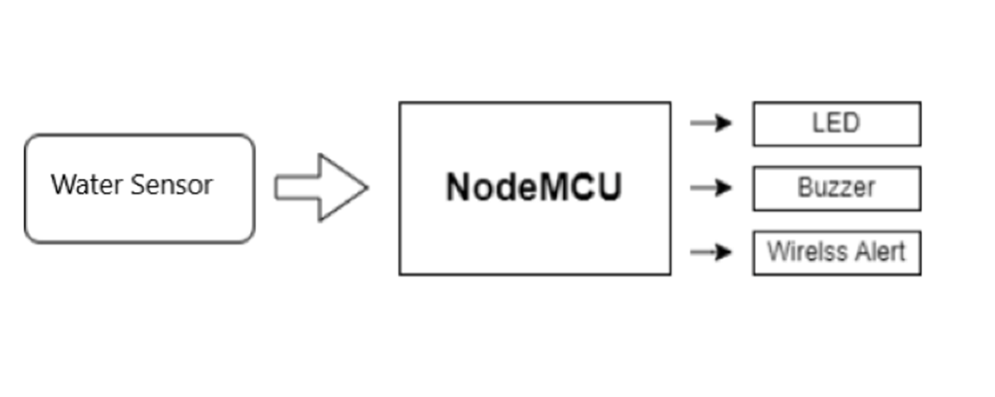
Circuit Diagram

Slide 9
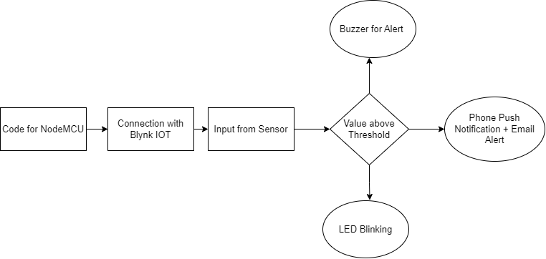
System Design

Slide 10
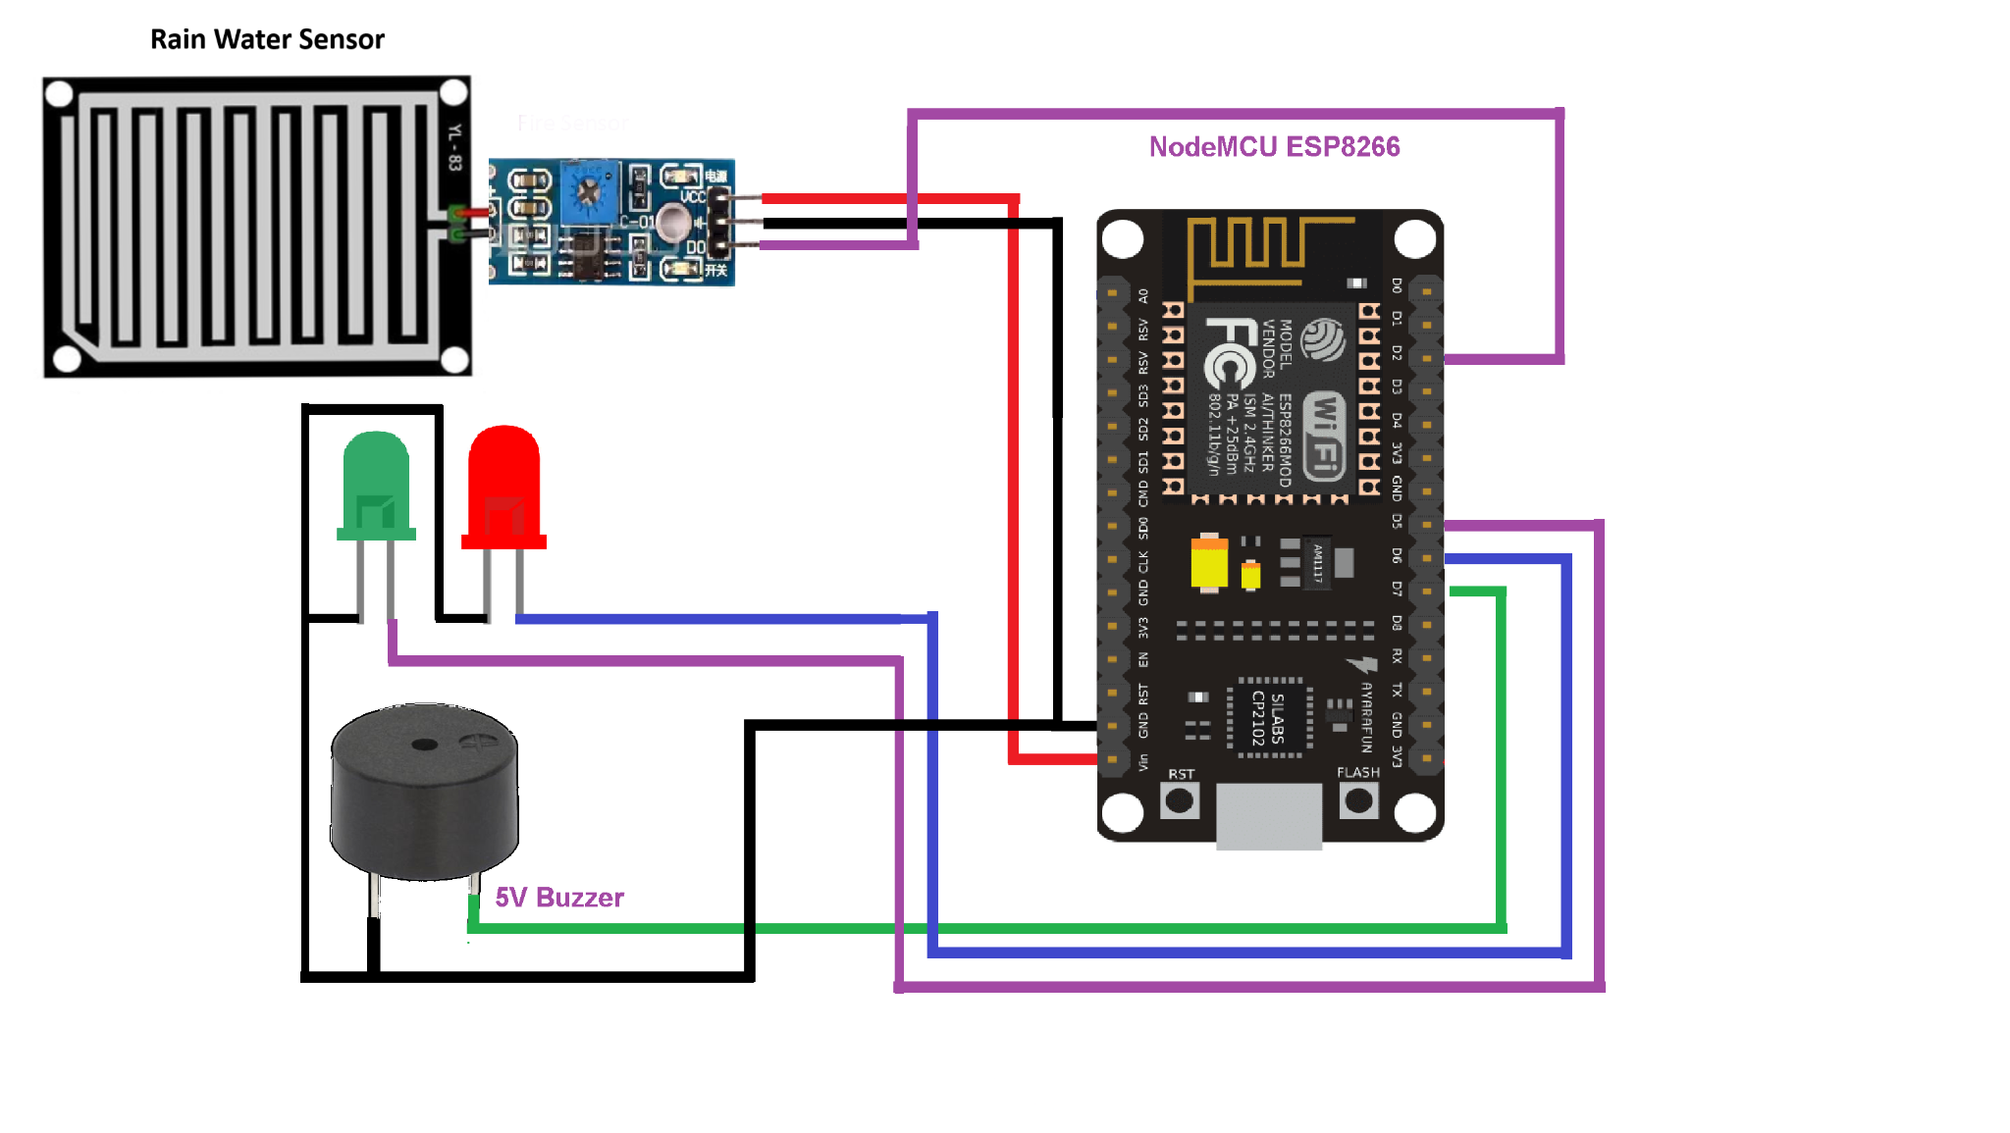
Visual Diagram

Slide 11
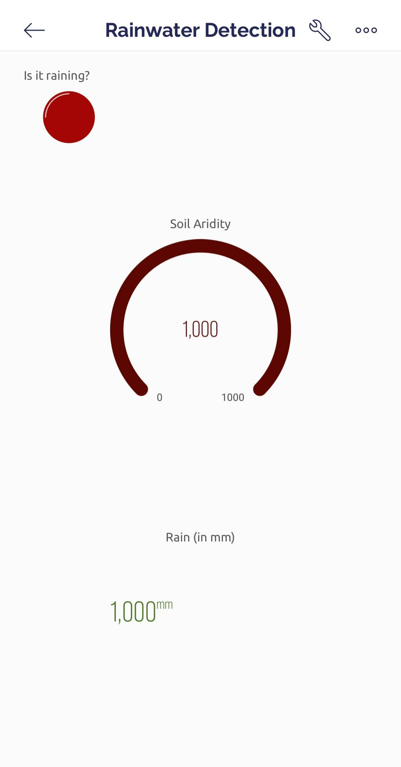
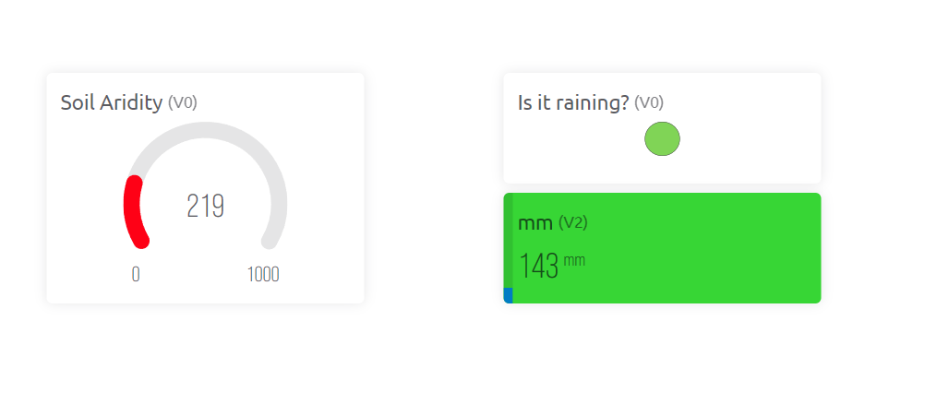
Results
Mobile and email Push Notifications

Slide 12
Hardware and Software Requirements
Hardware
Nodemcu Esp 8266
Buzzer
Led
Rainwater sensor
Jumper wires
Breadboard
USB cable type A/B
Software
Blynk IOT platform

Slide 13
Conclusion
In conclusion, an automatic rain detection system using a nodemcu can be created to accurately detect and measure rainfall.
The system should be designed to be reliable and able to withstand a variety of environmental conditions. The system should also be designed to be low-cost and easy to maintain.
Overall, a rainwater detection system using ESP8266 is a great way to automate the process of monitoring rainfall and provide accurate data for a variety of purposes.

Slide 14
References
[1] "Development and evaluation of a low-cost rainfall detection system for urban hydrology" by S. Kim, S. S. Yeo, and J. Kim, 2019.
[2] "Rainfall estimation using microwave links from cellular communication networks" by M. Tsukamoto, T. Kawanishi, and H. Hanado, 2018.
[3] "Design and development of a smart rainwater harvesting system for domestic households" by S. S. Vaishnav and S. S. Deshmukh, Sustainable Cities and Society, 2018.

